Slide 1
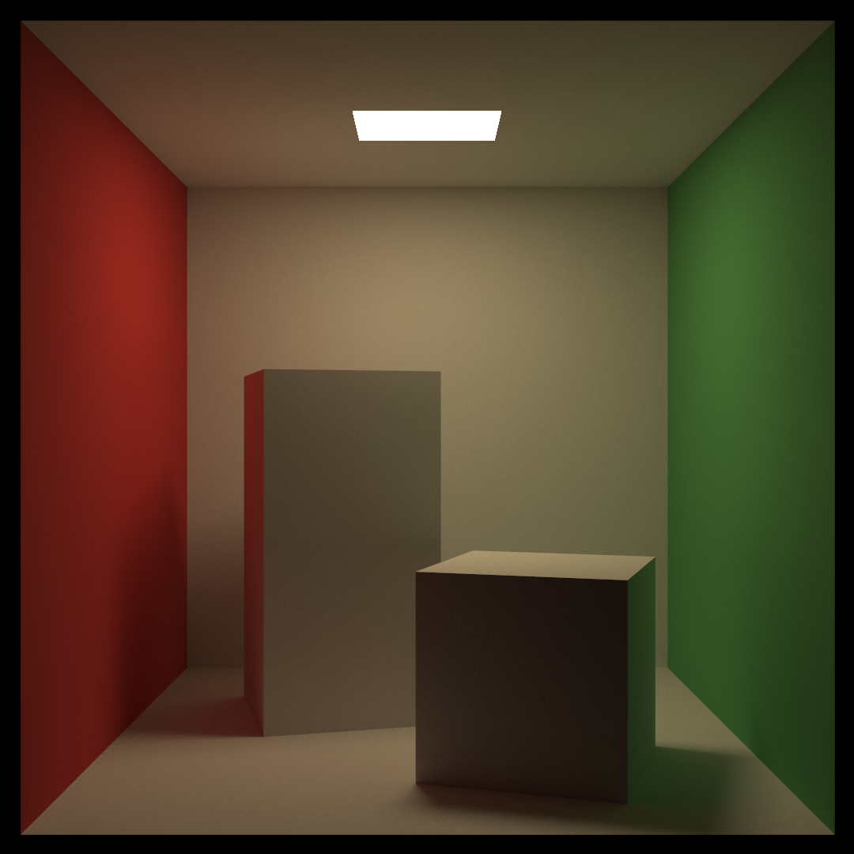
Raytracing Workshop

Slide 2
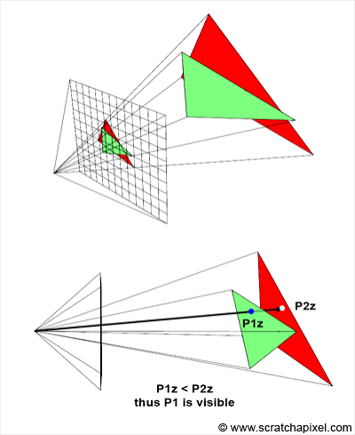
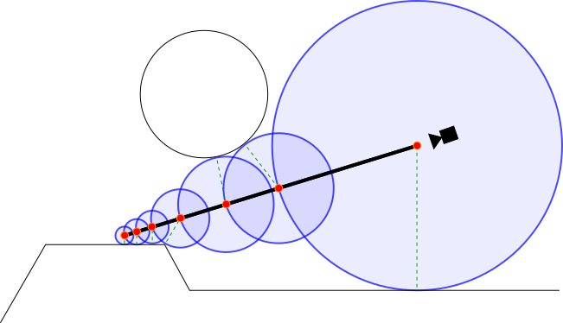
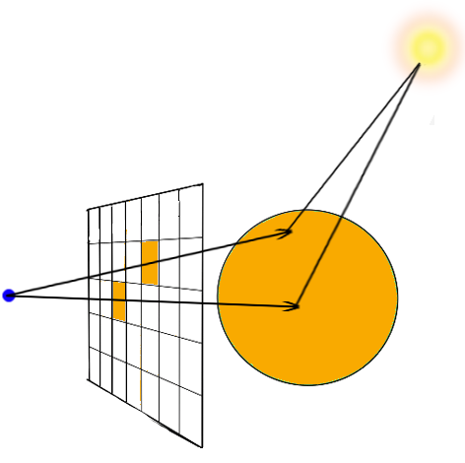
Motivation
How do we render a 3d scene to a 2d image?
Rasterization
Ray Marching
Raytracing

Slide 3
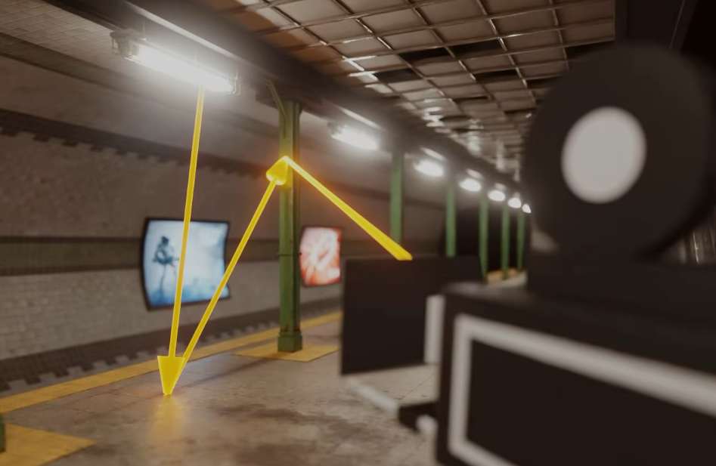
How do we simulate light?
Treat individual photons as a ray
Rays come from light sources with an intensity and a color
Rays bounce around the scene and “collect” color
Rays hit the camera sensor
Realistic, but very slow

Slide 4
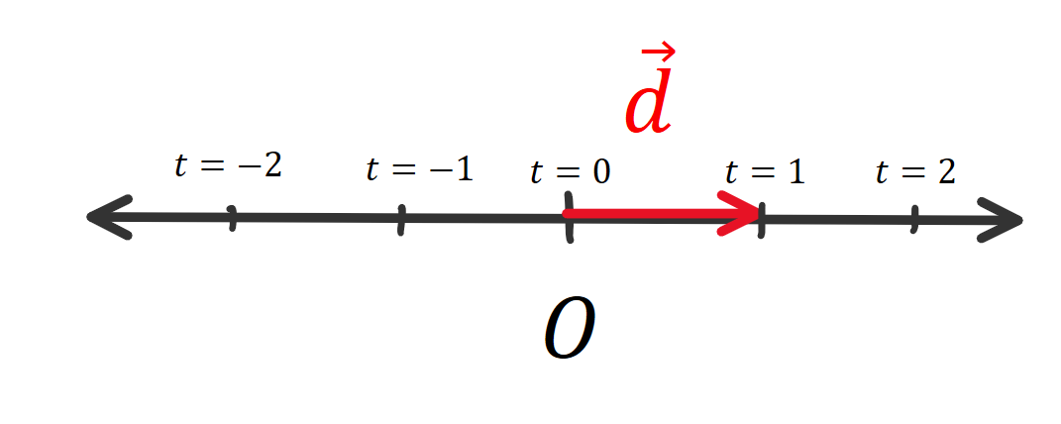
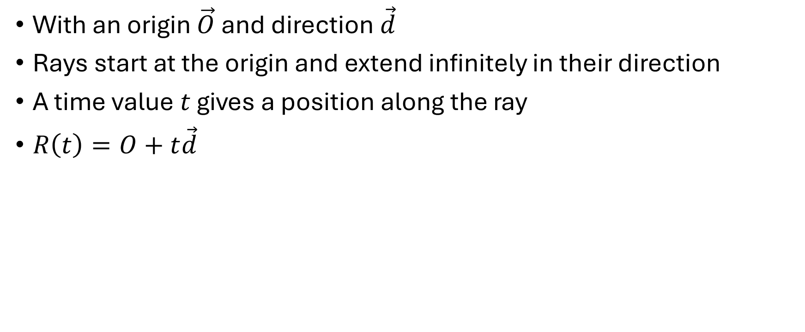
How do we represent rays?
With an origin $\vec{O}$ and direction $\vec{d}$
Rays start at the origin and extend infinitely in their direction
A time value $t$ gives a position along the ray
$R\left(t\right)=O+t\vec{d}$

Slide 5


Make it faster
Multiplying RGB components approximates “collecting” light
Multiplication is communitive
Bounce the rays in reverse
.16 .75 0
2, 2, 0
1 1 1
.08 .38 .51
.08
.38
.51

Slide 6
How do rays bounce?
Unlike ray marching, rays do not “move forward”
We find the intersection points analytically
Different formula for each shape in the scene
Produces the time and point of intersection
Produces the normal vector at that point

Slide 7
Ray – Sphere intersection
todo

Slide 8
Ray scattering
After a ray hits a surface, we need to scatter it
Influences the material properties of the surface
Diffuse scattering
Lambertian scattering
Reflective scattering
Dielectric scattering (next week)

Slide 9
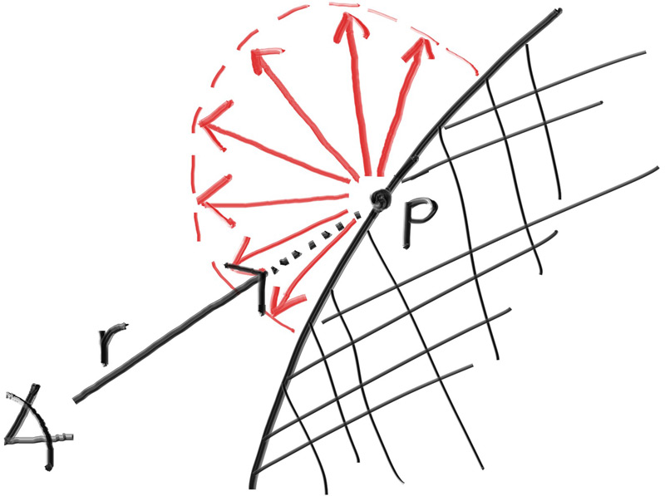
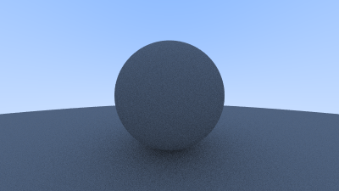
Diffuse scattering
Mimics rough, non-reflective surfaces
A ray is bounced in a random direction in the same hemisphere as the normal

Slide 10
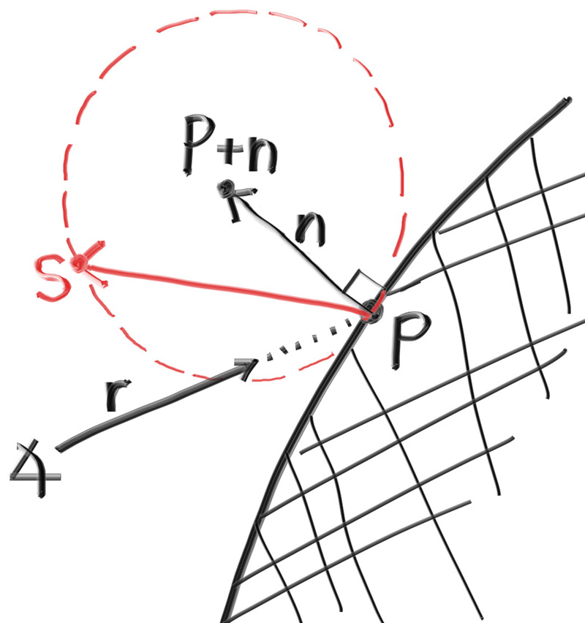
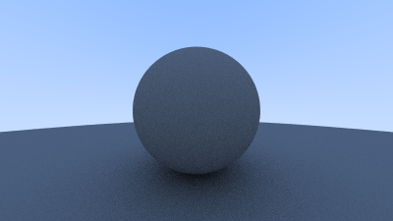
Lambertian scattering
Similar to diffuse scattering
Rays are more likely to scatter near the normal

Slide 11
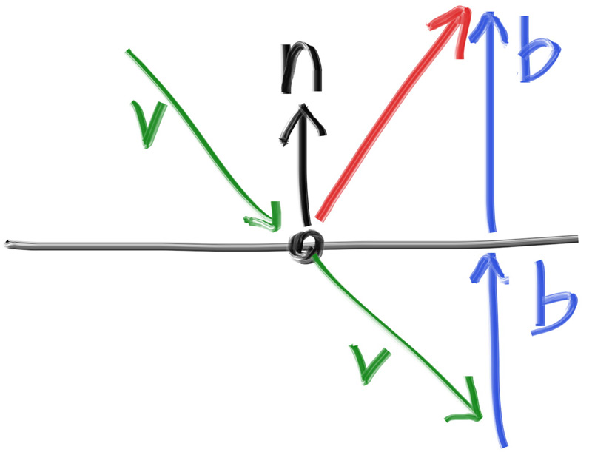
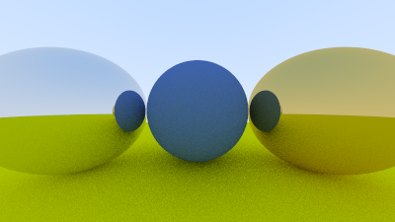
Reflective scattering
Used to mimic metals, mirrors, and other reflective surfaces

